Slide 1

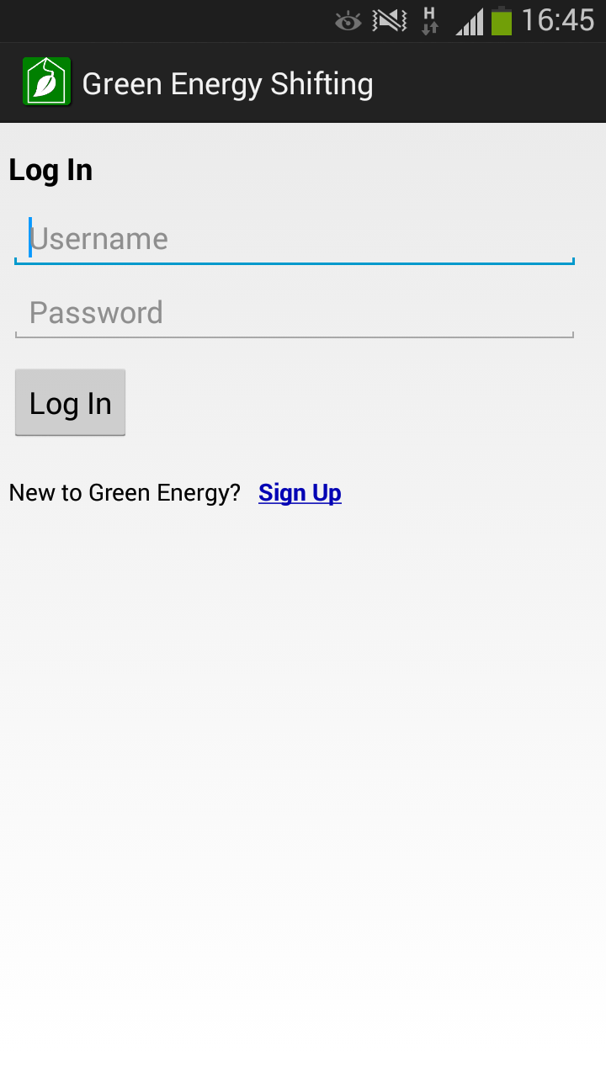
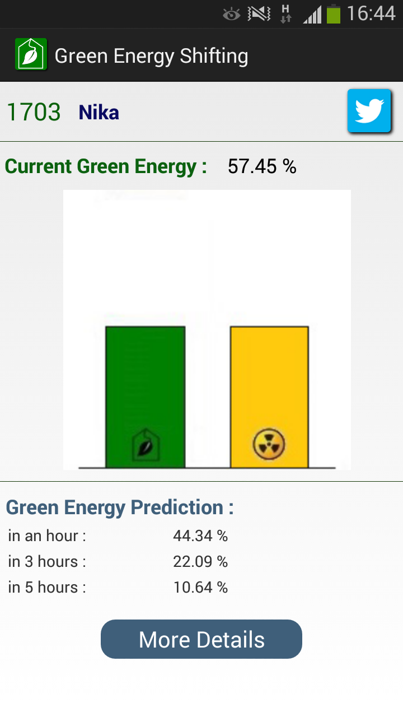
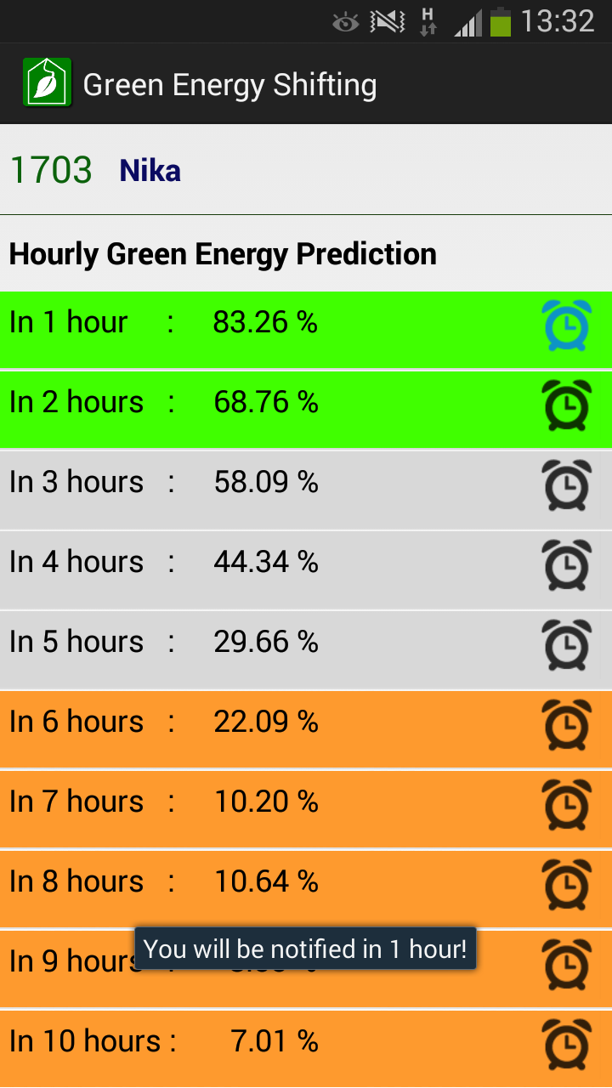
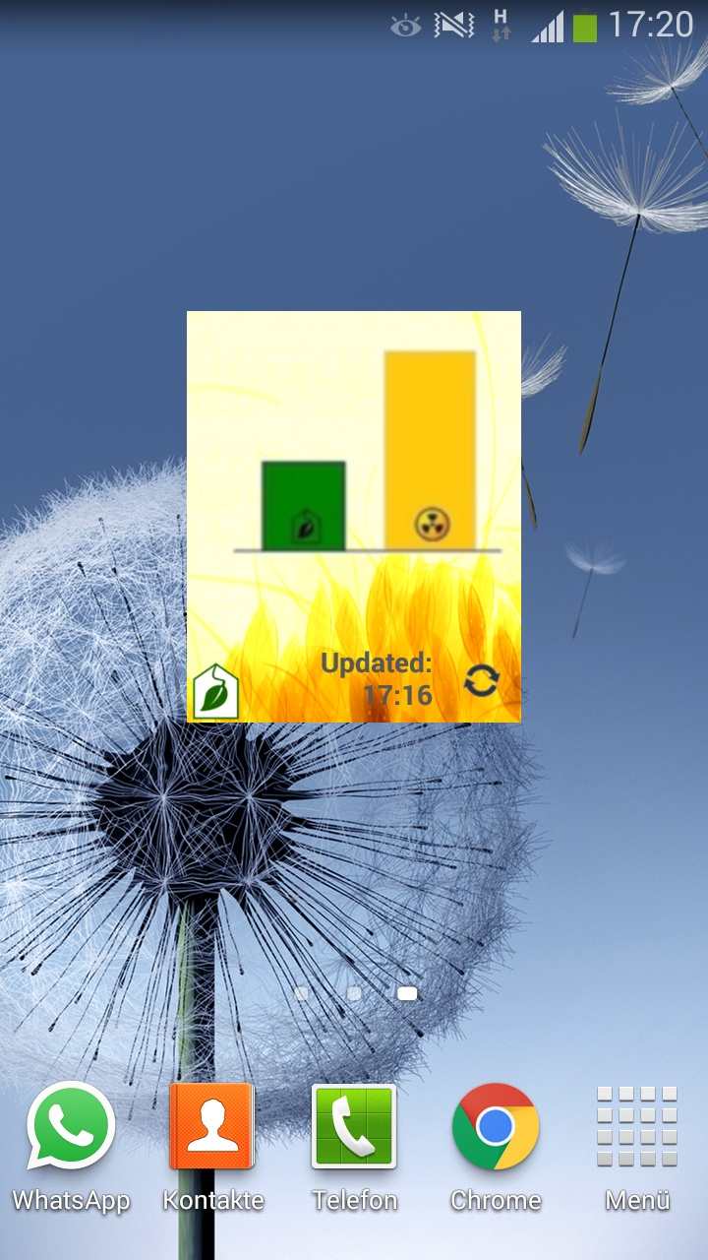


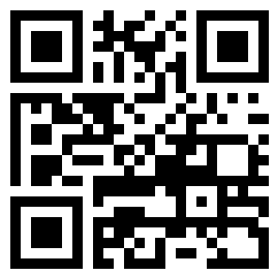


Green Energy Shifting App
Save Energy for a Greener Future!
Developed by: Veronika Henk, Sarvenaz Golchin, Mahnaz Hajibaba
Mentors: Prof. Sören Auer, Dr. Simon Scerri
Overview
There are certain times when large amounts of renewable energy are produced (e.g. when the sun is shining or when it is windy) and other times when we have to rely on conventional energy. We can influence our energy consumption by deciding when to turn our washing machines or dishwashers on. This Android application advises you about the best times to use energy.
User Guidance
You need to have an account
Log In (Fig. 1)
→ Your username and password are saved in your smart phone until
you log out
→ The password must be at least five characters
The Main Page (Fig. 2) shows current green energy
The Details Page (Fig. 3) shows prediction of green energy
The Widget (Fig. 4) gives a quick overview of the current green energy
By publishing your scores on Twitter, you get scores.
According to green energy predictions, you can set a reminder for the best time.
You will also get scores if you set a reminder for green or grey time.
Green energy compared to conventional fuel
Figure 1: Log In
Figure 2: Main Page
Figure 3: Details Page
Green: high, Grey: medium, Orange: low
Figure 4: Widget
Difficulties
Unable to access the server from outside the university
network
Web services and data are on a private webspace
Unable to acquire real live-data
Data
Hourly ex-ante and ex-post test-data from May 15th, 2012
Retrieved from “Transparency Data Interface
Specification” by “EEX Information Products”
Implementation
The main part of the system is Android development,
written in Java with Android SDK
→ Compatible Android versions 2.3 - 4.4.4
Connection to external database is implemented via
web services written in PHP
→ PHP version 5.2.17
→ MySQL version 5.6.19
Testing
In order to improve testing coverage, test application assumptions and validate application functionality, we used two methods:
Unit testing; to increase the stability and quality of the application and reduce testing costs
Integration testing; to verify the expected performance of the application components
Virtual Machine and Remote Access
Workstation name: EIS03
Hostname: vm – db
Path to project files: /opt/lampp/docs
(including SQL-files with the data version of 09-30-2014)
More details on “EIS Lab Workstations” poster
Source Code and Documentation
https://github.com/EIS-Bonn/MA-INF3232- Lab/tree/master/SomSem2014/Group%20H%20(GreenShifting_Scerri)
EIS
Download the App
Enterprise
Information Systems

